Slide 1
Development of Shelter Navigation with Considering Three Cs in the Corona Age
Hiroto Nakada
Himeji Nishi Senior High School
GSC-ROOT Program, Kobe University
Cooperated by
Toshiki Murotani
Masahide Nakamura
Graduate School of System Informatics, Kobe University
Notes:
姫路西高校の中田ひろとです．
今から，私の研究，”Development of ….. “ コロナ時代の密を考慮した避難所ナビゲーションの開発を発表いたします．

Slide 2
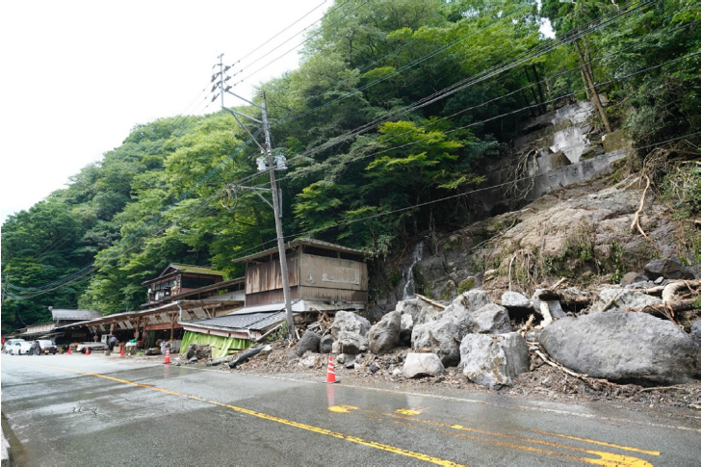
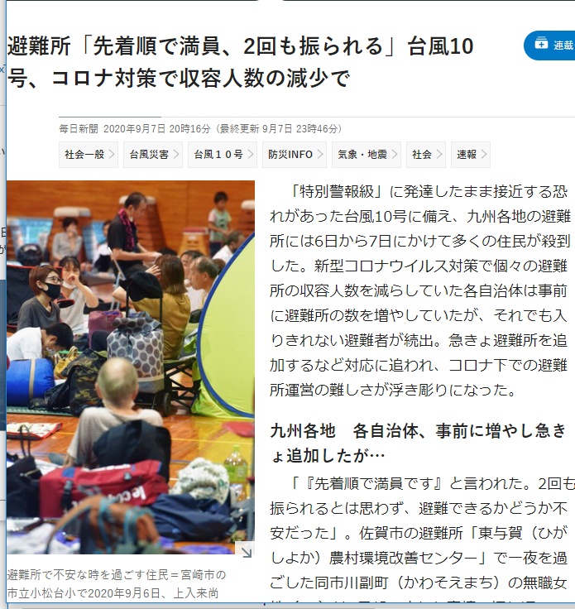
Disaster Evacuation in Japan
People fail to evacuate in disaster
Lack of awareness & preparedness
Normalcy bias: “My house may be safe”
Unaware of when/where to evacuate
COVID-19 makes things worse
Citizens hesitate to evacuate
Afraid of the risk of infection
The capacity of shelter is limited
Government wants to avoid 3C
Shelters may refuse to accept people*
How the disaster evacuation in the corona age should be?
*Source: CWMD, Kumamoto Univ. 2020-07
*Source: Mainichi Shinbun 2020-09-07
Notes:
日本は災害大国です．
毎年災害に見舞われ，多くの人が逃げ遅れによって，なくなっています．
これは，・・・・

Slide 3
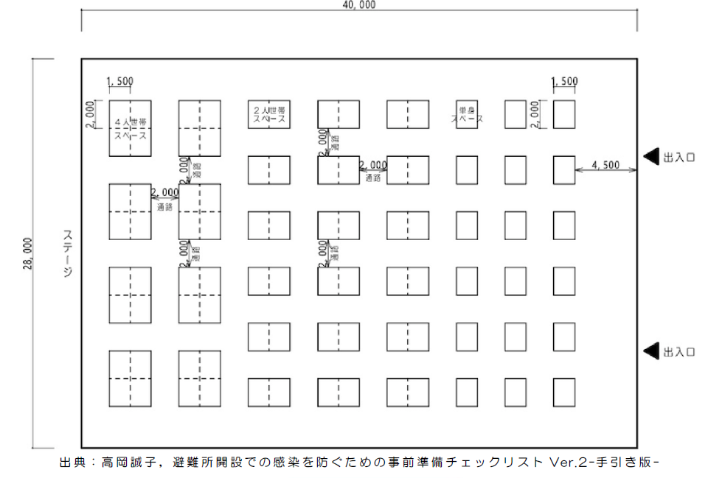
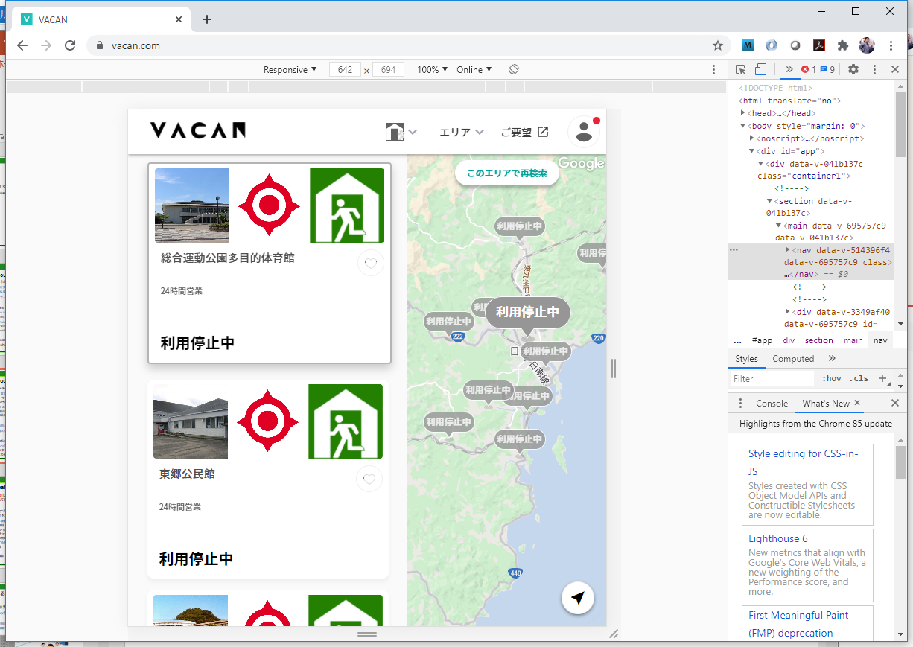



Struggles of Local Governments
Develop corona-aware evacuation shelters
New guideline avoiding 3Cs in shelters
Sparse Layout & Floor Plan, Thermometry, Health Inquiry, Phone-based Alert, Safety Confirmation…
Online Delivery of Congestion Information
Smartphone App “VACAN” (Nichinan-City, Miyazaki)
Staff manually update the status on site
Completely relying on local government
New policies add heavy workload to staff
Lack of scalability for # of citizens / shelters
Research Question
In the corona age, how can citizens find appropriate shelters by themselves, without relying on governmental staff?

Slide 4


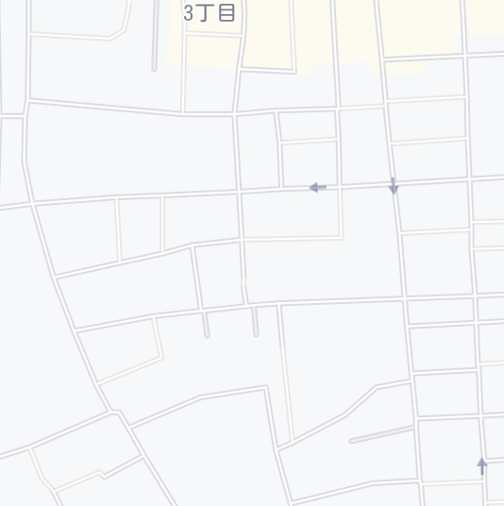




Research Goal and Approach
Research Goal
Achieve safe and smooth evacuation avoiding 3Cs in shelters by self-help effort of citizens
Approach
Develop Shelter Navi – A smartphone-based navigation app.
Cloud server manages location & status of shelters
Citizens search shelters with the status with app
As citizens “check in”, the system updates the status
search
Shelter name | Address | Max # of families | Current status
A high school | XX town 1-2 | 50 | 48
B element. school | YY town 4-5 | 30 | 20
C comm. center | YY town 11-4 | 10 | 6
D sports center | WW town 8-9 | 125 | 22
A
B
check-in
C
D
+1

Slide 5


Citizen’s Use Cases
C1: Register household information
Name, home address, email, phone, # of families
C2: Search shelters
System visualizes shelters with congestion status on a map
With the map, citizen searches a shelter to evacuate
C3: Check-in at shelter
Citizen moves to the shelter, and presses “Check-In” button
System records the check-in, and updates the status of the shelter
Crowded
Disaster Alert
NAME:
Hiroto Nakata
ADDRESS:
X town 33-2
EMAIL:
hiroto@aaa.jp
PHONE:
079-9123-4567
# of FAMILY: 4
2020-10-03 12:00
Muronani Toshiki
Check in at
D Sports Center
check in
2020-10-03 12:05
Nakada Hiroto
Check in at
D Sports Center

Slide 6

Local Government’s Use Cases
G1: Register shelter information
Shelter name, address, lat, lng, capacity, description
G2: Check status
System shows the current status of every shelter
Staff checks if the status matches the real situation
G3: Confirm safety of particular citizen
System shows the list of evacuated citizens at every shelter
Staff confirms the safety of any particular citizen
Shelter name | Address | Max # of families | Current status
A high school | XX town 1-2 | 50 | 48
B element. school | YY town 4-5 | 30 | 20
C comm. center | YY town 11-4 | 10 | 6
D sports center | WW town 8-9 | 125 | 22
Disaster Alert
SHELTER NAME:
A High School
ADDRESS:
XX town 1-2
Lat-Lng: 134.6867,34.8434 Max # of families:
50
List of Citizens D sports Center
-----------------------------
NAME CHECK-IN #
---------------------------------
Nakada H. 12:00 5
Murotani T. 12:05 4
：
Crowded

Slide 7








System Architecture
Implement Shelter Navi as Web Application
Server Side: Layered Architecture with REST-API
Java Web Service with Spring Boot
Integrated with Google Maps
Client Side: HTML/JS on Web browser
Responsive Web design with Bootstrap
Client-Side
Server-Side
Citizen Web-API
Government Web-API
REST Controller
Business Logic
Internet
Citizens
Data Base
Map Service
Google Maps Platform
Government

Slide 8
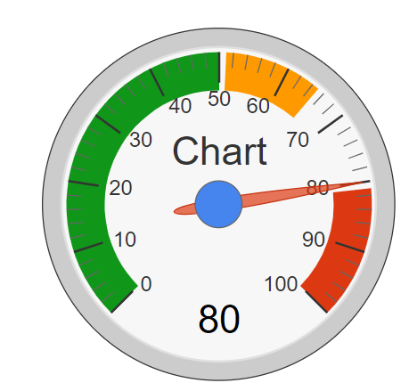
Technical Details
Domain modeling
Shelter: sid, name, address, lat, lng, capacity, isActive, manager
Citizen: cid, name, email, password, home address, # of families
Check-In: id, cid, sid, check-in datetime, check-out datetime
Search shelters by distance
Obtain current (x,y) from GPS
Find shelters S(lng, lat) such that ; d(lng, lat) = 6371 * acos (cos(rad(y)) * cos(rad(lat)) * cos(rad(lng) – rad(x)) + sin(rad(y))*sin(rad(lat))) <= D
Calculate density of shelter
CheckIn(S): # of families currently checked in S
Capacity(S): Max # of families S can accommodate
Density(S) = CheckIn(S) / Capacity(S)
Shelter
1
0..*
Check-In
Citizen
0..*
1
D

Slide 9
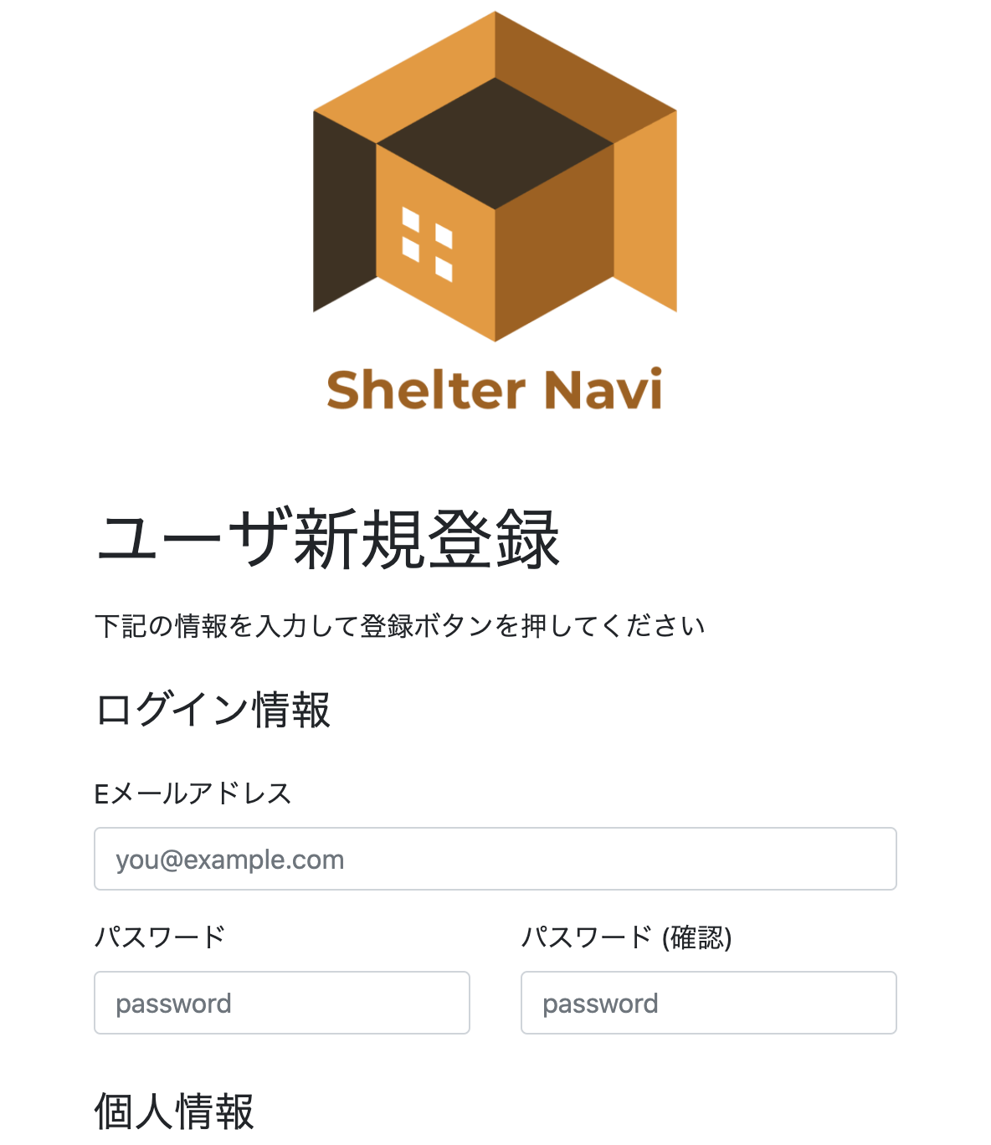
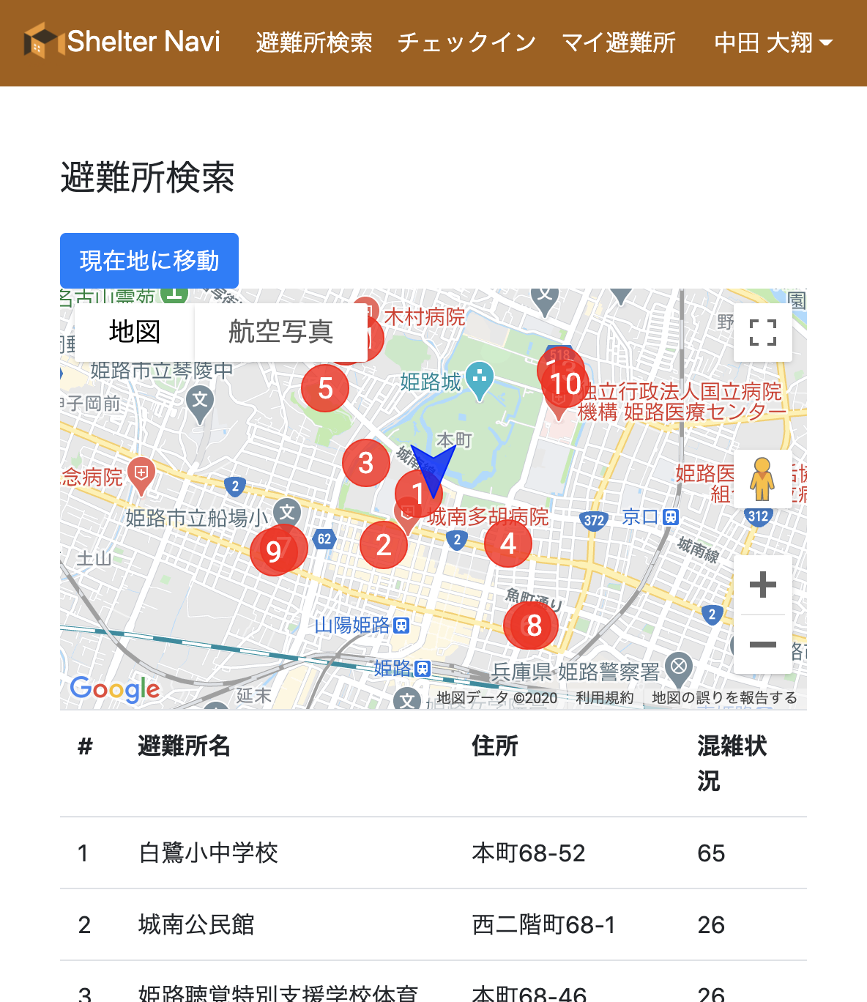
Screenshots of Prototype
We are currently implementing Shelter Navi with open data of Kobe City and Himeji City

Slide 10
Discussion
Advantage of Shelter Navi
Citizens can find vacant shelters by themselves
Shelter congestion is measured automatically by the system
Government staff can check the real-time status of every shelter
Limitations
Strict data management is needed (info, capacity, open/close)
Not easy for people unfamiliar with smartphone operations
Rely on mobile network infrastructure
Advanced Use Cases
Manage private shelters (houses of relatives/friends)
Integrate with public/local disaster information
Experimental Evaluation in Real Settings
Cooperation by local governments is inevitable

Slide 11
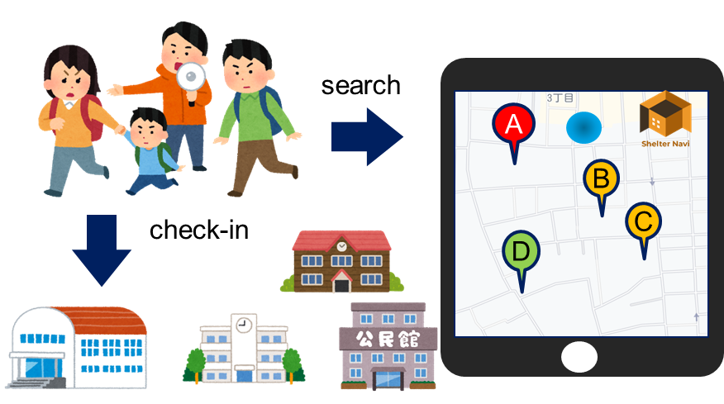
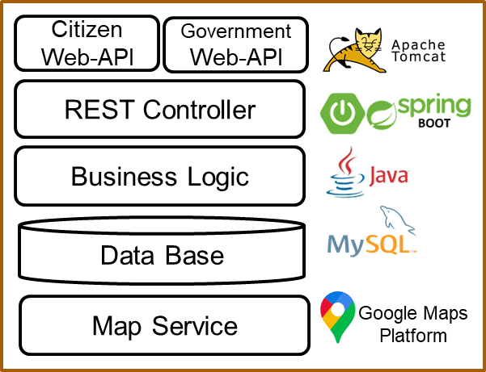
Summary
Study and develop Shelter Navi for disaster evacuation navigation in the corona age
Achieve safe evacuation with avoiding 3Cs in shelters by self-help effort of citizens
Presented basic use cases and system design
Ongoing Work
System development with Nakamura Lab. in Kobe University
Experimental evaluation in practical setting

Slide 12
Thank you for listening !

Slide 13
謝辞
神戸大学大学院システム情報学研究科
中村 匡秀 先生
室谷 敏生 様
JSTグローバルサイエンスキャンパス ROOTプログラム

Slide 14

5.アプローチ
『Shelter Navi』を開発する
自宅周辺の避難所を地図上に表示するとともに、避難所の混雑状況をリアルタイムで確認できるアプリケーション

Slide 15
6.提案手法
機能
避難所の混雑状況の確認
リアルタイムの情報を確認可能
地図上に表示
チェックイン・チェックアウト機能
住民がどこに避難したかが確認可能
これにより避難所の収容率を計算（職員の入力作業不要）
私的な避難所（Private Shelter)の登録
新たな避難様式に対応

Slide 16
評価

